Slide 1


What motivates people to buy or not buy reusable water bottles?
Project 6 - Ironhack -july 2021
Lucie Fleury

Slide 2


The Data
01
The dataset comes from a survey made on Google Form:
One survey aiming at people who don't have a reusable water bottle (8 questions)
One survey aiming at people who have a reusable water bottle (12 questions)
sample : 33 young adults in the Tech industry from Lisbon
(a mix of workers and students )
text

Slide 3
Sorting the data and data cleaning
01
Removing the Timestamp from the Google Form
Some answers where free text :
-Adjusting "Both" and "Both."
-Correcting spelling (bottle vs botlle)
-1 wrong direction in the poll - deleted
Labels : to treat and categorize free text (to do)
ex: "plastic bottle" vs "water bottle"
Some answers difficult to label ex: "because it is important"
text

Slide 4
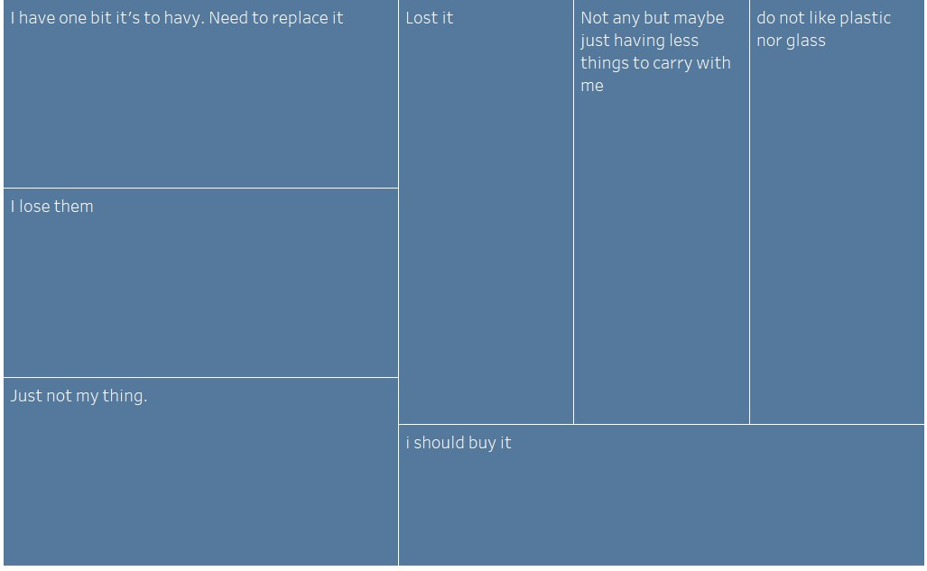
Reasons for not having a reusable bottle :
01
text

Slide 5
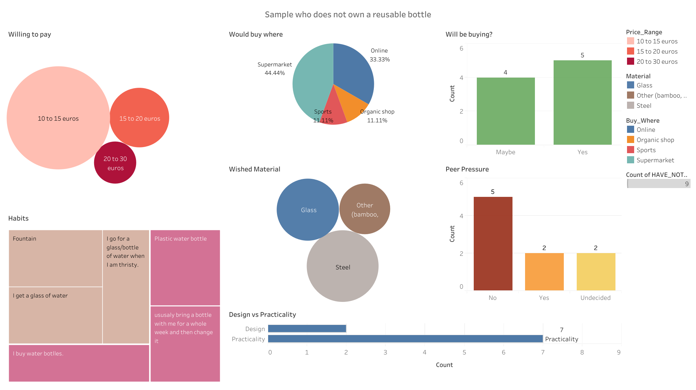
Notes:
looking at the tableau
it looks like the poll was not
but the questions included I don't want to buy
-> there are no firm no
possible biais or sample not big enough or people don't have a strong opinion about the subject

Slide 6
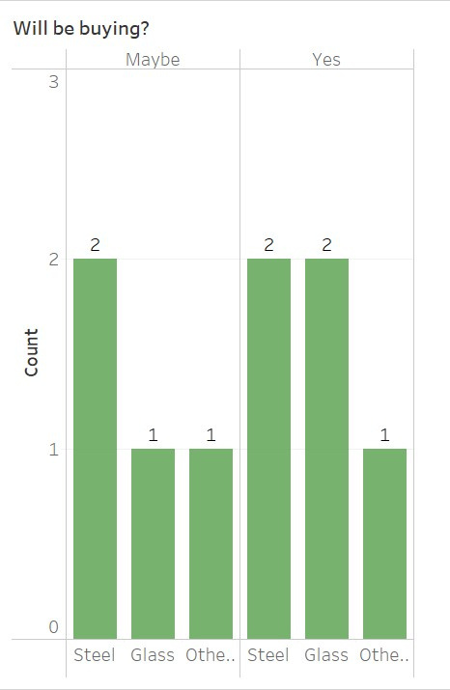
Review
01
A good portion of people from the sample showed intention to buy in the future :
They are more likely go for low price range
buy at supermarket or online
favor steel or glass and practicality
Another portion seems content with their habit as it is part of their routine or don't want to buy an unnecessary item
text

Slide 7
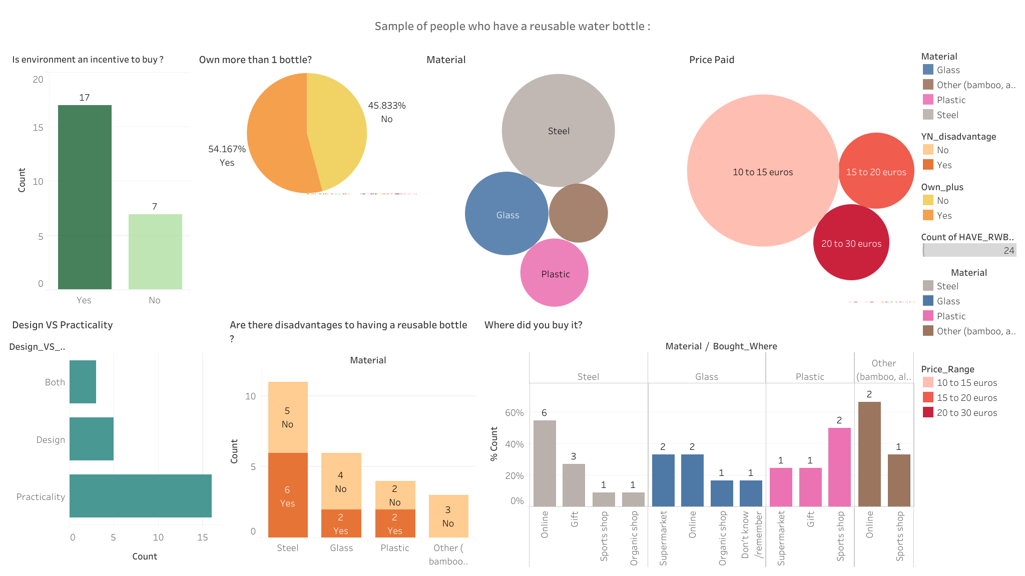
text

Slide 8

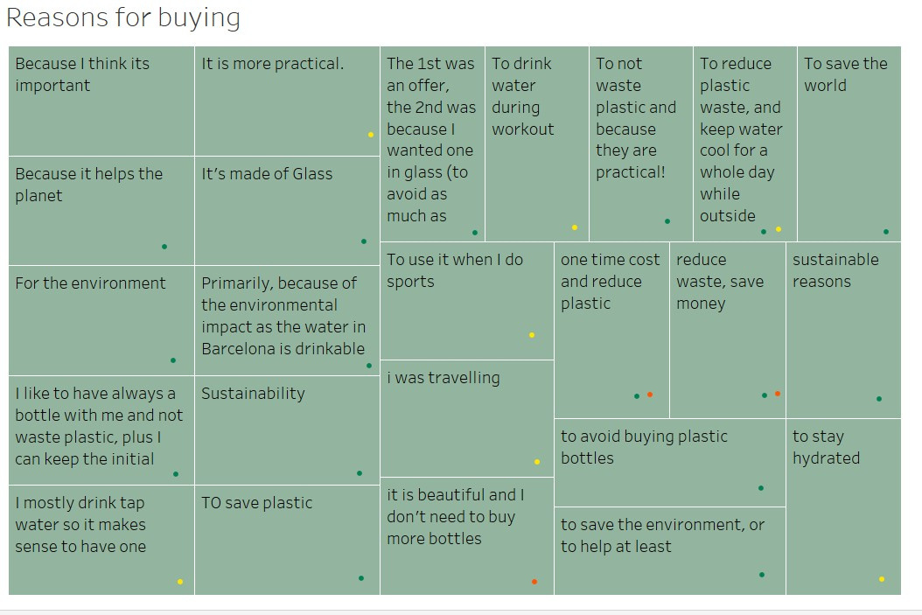
Why did you buy a reusable bottle?
Notes:
Green - environmental concern
Red - cost
Yellow practical aspect

Slide 9
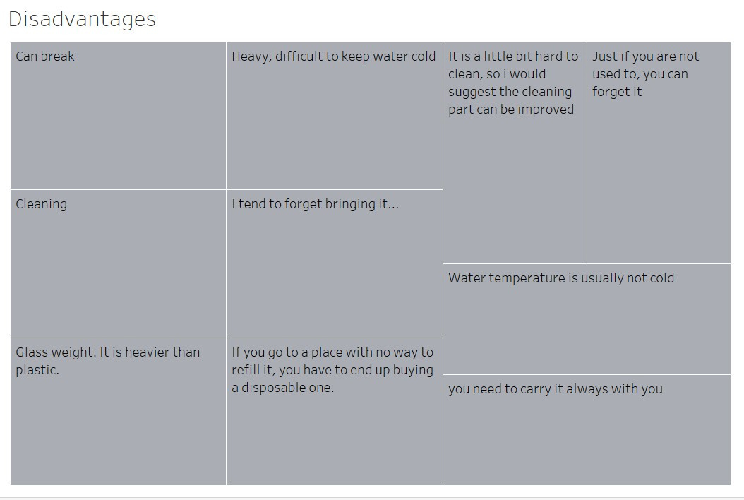
Review
01
text

Slide 10
Review
01
A good portion of people from the sample own more than one bottle :
They use them on daily basis (not shown in the Tableau - 100%)
They bought online followed equally by sports shop and receiving a gift
More prone to spend a bit more money and to also to look at designs
40 % of the sample experience some drawbacks (weight, deterioration, lack of structure to refill, losing or forgetting to bring it)
In the next slide, a certain amount of people would be interested in a bottle that keeps warm and hot drinks, easier to clean, leakproof
text

Slide 11
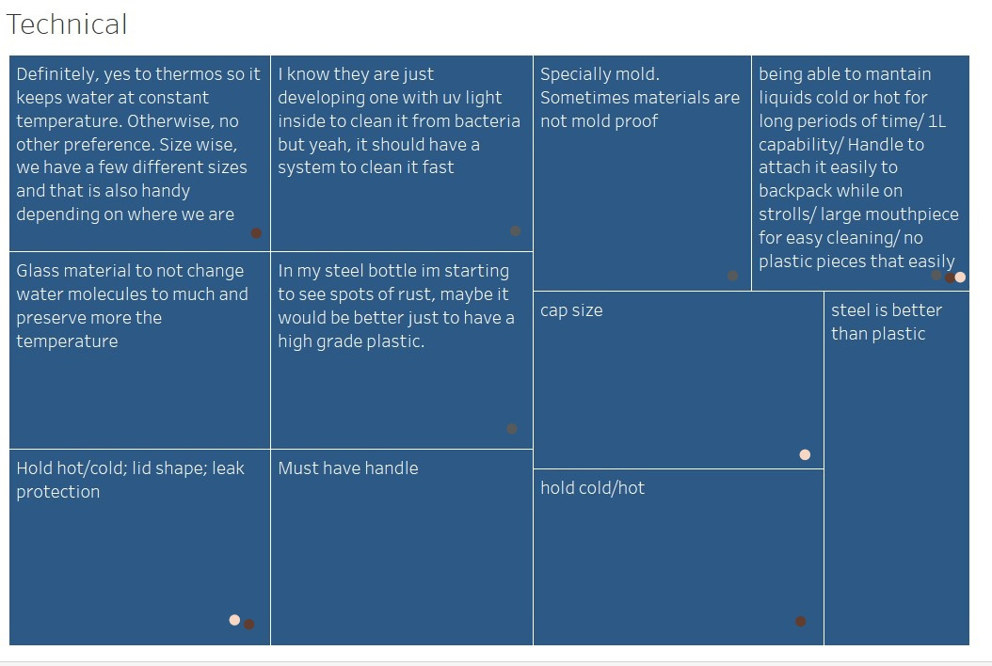
Do you have technical requirements or improvements to suggest for reusable water bottles? (44% answered yes - here are the results)
Notes:
Brown : thermos
Gray cleaning issues
Ivory : lid / cork improvement

Slide 12
Hypothesis testing
H0- Does having environmental concerns equates for individuals to possess a glass bottle?
H1- Do people who have glass bottles buy them because of environmental incentive ?
(statistic=0.8246211251235324, pvalue=0.42853661643356133)
Answer :pvalue indice > to 0,05
In this sample, we cannot reject the hypothesis.

Slide 13
Hypothesis testing
H0- people with glass bottle related to having more than one bottle
H1-Do people who have a glass bottle own more than one reusable water?
Ttest_indResult(statistic=-4.123105625617661, pvalue=0.0007103270462445615)
Answer :pvalue indice to 0,05
Having more bottles is not different from glass and non glass bottle owners,
we can reject the H0 on this sample
we were expecting people who have glass bottle to own only one

Slide 14
Recommendations
People who don't own a reusable bottle still represent a part of the market that it is worth investing in, however half of the people who own one also bought another or more.
It would be good to produce different products with different price range.
From the data, we can see that a portion of users is having issues with cleaning and leakage,
and is also interested in more isothermal bottles.

